Slide 1
Insights from Airbnb Analysis from Pre-COVID Period

Slide 2
Agenda
Objective
Background
Key Findings
Recommendations
Appendix:
Data sources
Data methodology
Data model assumptions

Slide 3
Objective
Improve our strategy for reviving the business after COVID.
Understand critical insights from the Airbnb NYC business before COVID.
Estimate customer travel preferences for the post-COVID period.

Slide 4
Background
Because of travel limitations caused by the COVID-19 epidemic.
Airbnb revenue fell the most in NYC in the second quarter of 2020.
Now that the travel restrictions have been eased, the company should be run to recover the damage.

Slide 5
Key Findings
Customer preferences and evaluations, as well as the average price of different Airbnb hosts, were examined.
The data was studied to glean significant information from the Pre-COVID era.
The insights will be utilized to make judgments for the NYC Airbnb business regarding travel after COVID.

Slide 6
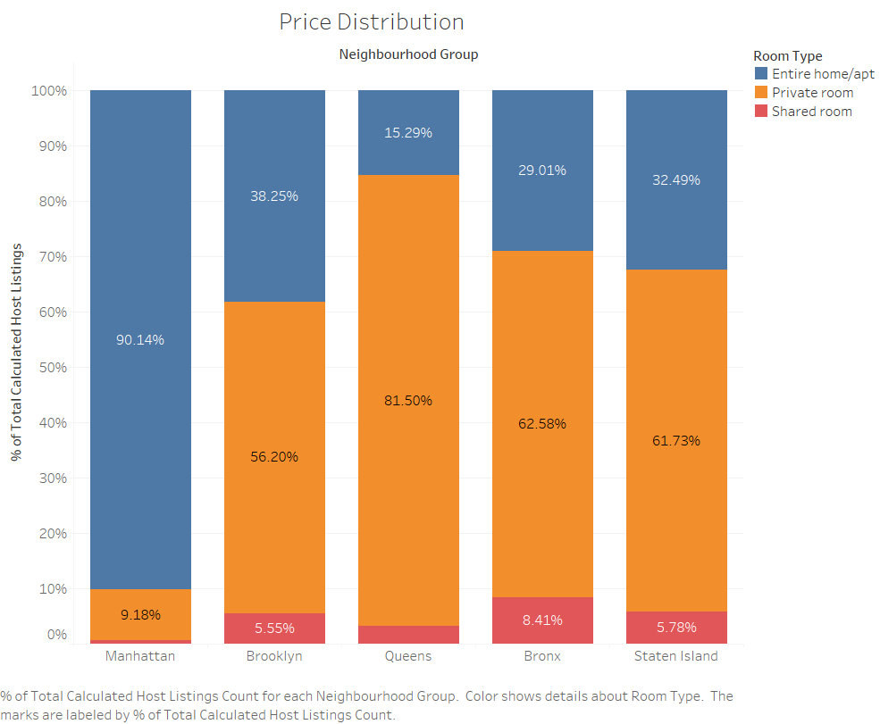
Preferences of customers for Properties in NYC Areas
Manhattan has the most expensive real estate in the world.
When compared to the total contribution of 'Entire home/apt,' Manhattan has the highest contribution of 'Entire home/apt'.
When compared to the overall contribution of 'Private room,' Queens has a higher contribution of 'Private room'.

Slide 7
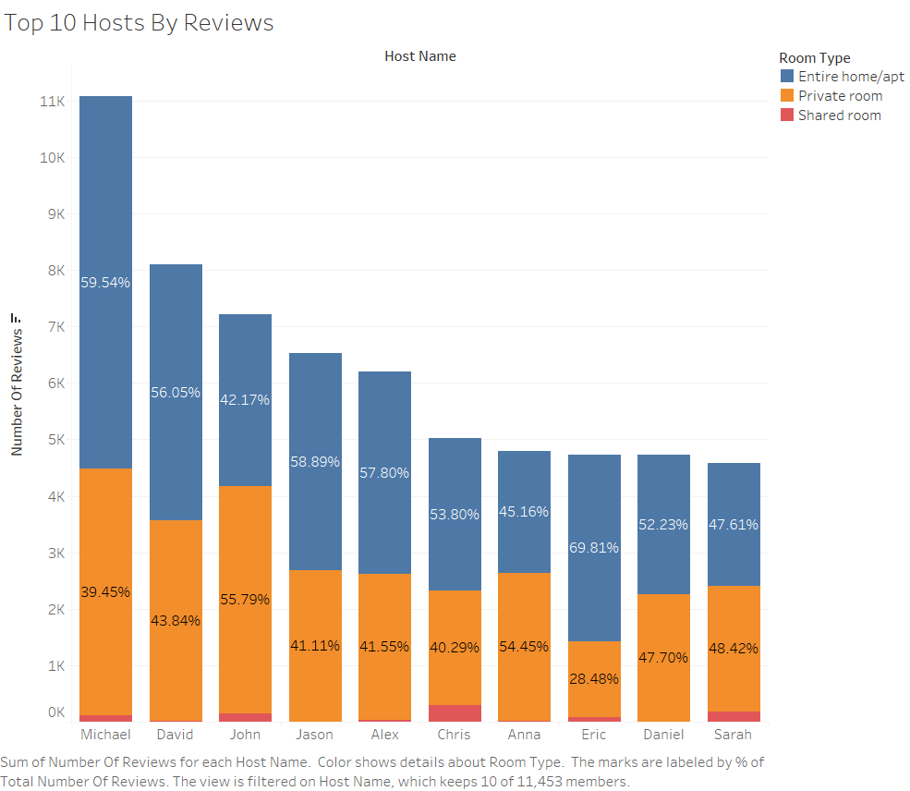
Top 10 Hosts By Reviews
Shared rooms have the fewest reviews of all the listed properties
More than half of the hosts prefer renting out the entire home/apartment
Private room & Entire home/apartment appear to be popular (more than 90% reviews)

Slide 8
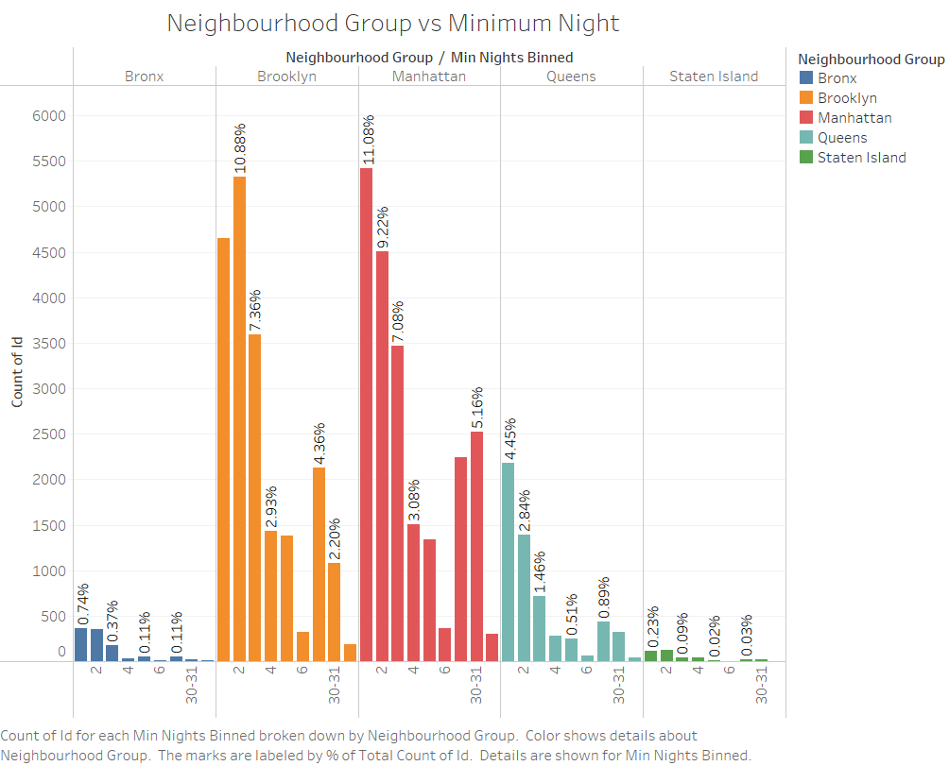
Neighborhood Group Preferences Regarding Minimum Nights
20% of bookings are made in Manhattan or Brooklyn.
Because Manhattan and Brooklyn are expensive places, most guests prefer to stay for less than three nights.
Staten Island is still in development, whereas the Bronx is the poorest borough, with only 10% of residents preferring to rent.

Slide 9
Recommendations
Airbnb hosts are classified into two types: Regular and Super Hosts
Super Hosts are those that have more than 80% of their reviews and provide at least 10 stays every year.
The rest are considered regular hosts.

Slide 10
APPENDIX – DATA SOURCES
Here's a look at our data dictionary. Host information such as Id, name, host name, and host id. Property Listings information such as latitude, longitude, price, and room type.
The following data sources were used by the team: Data given by the Upgrade Team Airbnb listings data from NYC Survey done in 2019

Slide 11
APPENDIX – DATA METHODOLOGY
The Airbnb dataset was thoroughly examined by us. Cleaning the dataset by addressing missing values was part of the process.
In Tableau, create new calculated fields 'Min Nights Binned' and 'No. reviews Per Listing’ in Tableau.
Creating visualizations with the Tableau tool to help you comprehend significant findings from the analysis.

Slide 12
APPENDIX – Data Model Assumptions
We assumed the data before to the COVID - 19 era was reaching the required income.
We assumed the company does not wish to expand to new territories in NYC just yet.
The company's strategies are determined with the assumption that travel will increase in the post COVID time.

